Slide 1
Registers

Slide 2
Objectives
Introduction
Types of Registers
  SISO
  SIPO
  PISO
  PIPO
  Shift Registers and its applications

Slide 3
Introduction
What is a register?
    A digital building block often used to store binary information temporarily in electronics.
    Group of flip flops used to store binary data.
    A Binary register also forms the basis for some very important arithmetic operation.
    Also used to form different types of counters.

Slide 4

Types of Registers

Slide 5
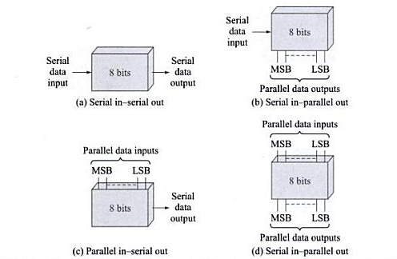

Slide 6
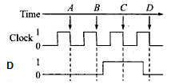
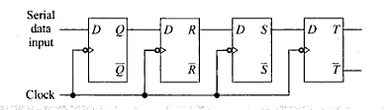
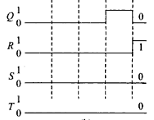
Serial In Serial Out(SISO)

Slide 7
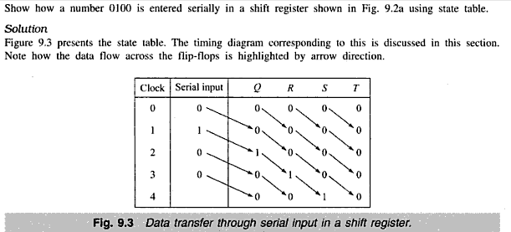
Clear

Slide 8
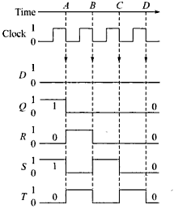
How to shift the data out of the register?
In order to get the data out of the register, they must be shifted out serially. This can be done destructively or non-destructively. For destructive readout, the original data is lost and at the end of the read cycle, all flip-flops are reset to zero.

Slide 9
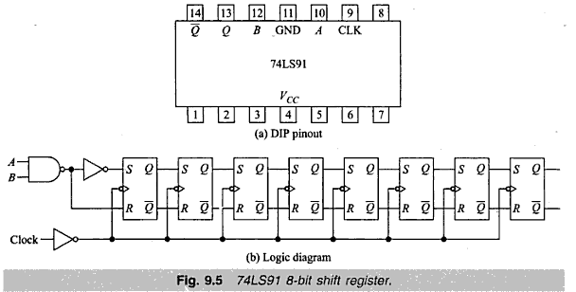
8-bit shift register

Slide 10
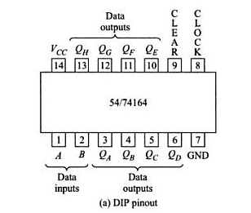
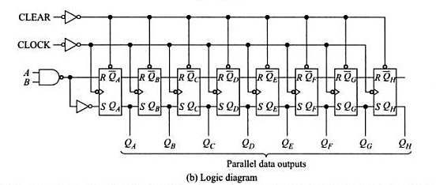
Serial In Parallel Out (SIPO)

Slide 11
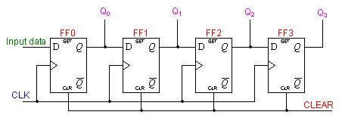
4-bit SIPO shift register
The practical application of the serial-in/parallel-out shift register is to convert data from serial format on a single wire to parallel format on multiple wires.

Slide 12
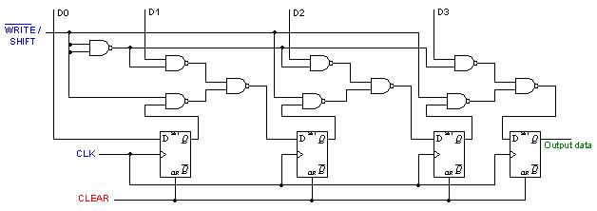
PISO 4-bit shift register
The circuit uses D flip-flops and NAND gates for entering data (ie writing) to the register.
D0, D1, D2 and D3 are the parallel inputs, where D0 is the most significant bit and D3 is the least significant bit. To write data in, the mode control line is taken to LOW and the data is clocked in. The data can be shifted when the mode control line is HIGH as SHIFT is active high.

Slide 13
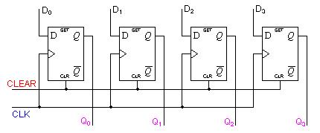
PIPO 4-bit shift register
The D's are the parallel inputs and the Q's are the parallel outputs. Once the register is clocked, all the data at the D inputs appear at the corresponding Q outputs simultaneously.
The D's are the parallel inputs and the Q's are the parallel outputs. Once the register is clocked, all the data at the D inputs appear at the corresponding Q outputs simultaneously.
The D's are the parallel inputs and the Q's are the parallel outputs. Once the register is clocked, all the data at the D inputs appear at the corresponding Q outputs simultaneously.
The D's are the parallel inputs and the Q's are the parallel outputs. Once the register is clocked, all the data at the D inputs appear at the corresponding Q outputs simultaneously.
For parallel in - parallel out shift registers, all data bits appear on the parallel outputs immediately following the simultaneous entry of the data bits.
The D's are the parallel inputs and the Q's are the parallel outputs.
Once the register is clocked, all the data at the D inputs appear at the corresponding Q outputs simultaneously.

Slide 14
Application of Shift register
Ring Counter
Switched Tail Counter
Sequence Generator and Sequence Detector
Serial Adder

Slide 15
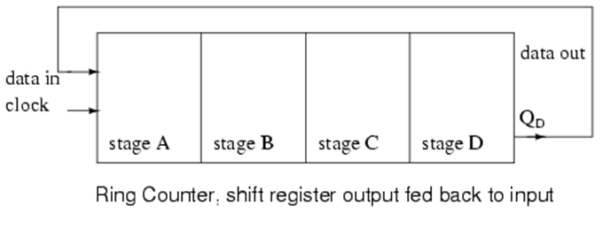
Ring Counter
If the output of a shift register is fed back to the input. a ring counter results. The data pattern contained within the shift register will re-circulate as long as clock pulses are applied.

Slide 16
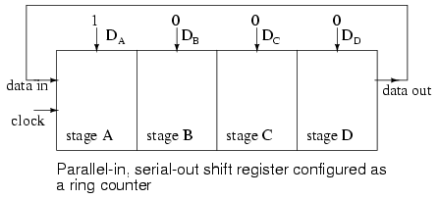
Any random pattern may be loaded. The most generally useful pattern is a single 1.
For example, the data pattern will repeat every four clock pulses in the figure below. However, we must load a data pattern. All 0's or all 1's doesn't count.
Loading binary 1000 into the ring counter, above, prior to shifting yields a viewable pattern. The data pattern for a single stage repeats every four clock pulses in our 4-stage example.

Slide 17
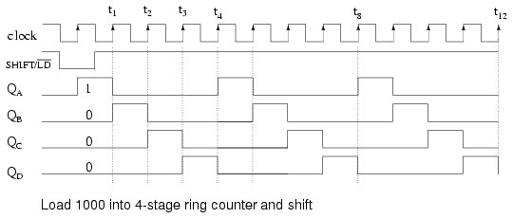

Slide 18
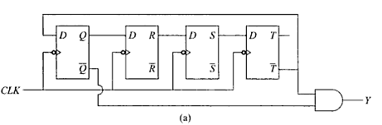
Switched Tail Counter
Also known as Twisted tail counter or Jhonson counter.
In a Ring counter the non-inverted output is fed back to the first flip-flop.
If the inverted output is fed, we get a switched tail counter.

Slide 19

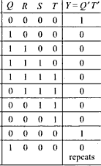

Slide 20
Sequence Generator and Detector
Useful in generating sequence pattern repetitively.
It checks the binary data stream and generates a signal when a particular sequence is detected.

Slide 21
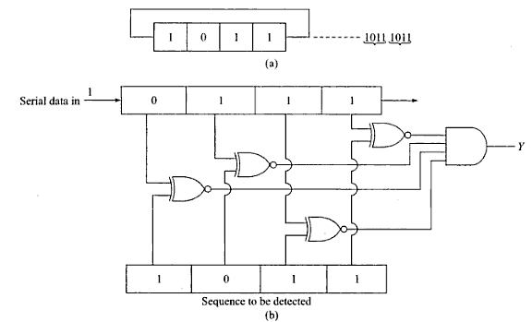

Slide 22
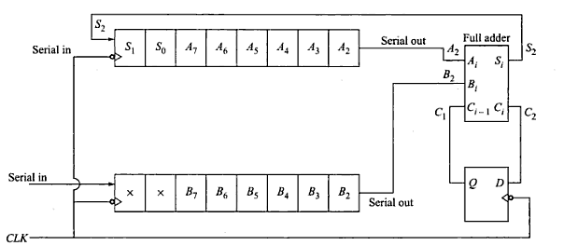
Serial Adder

Slide 23
Verilog code -> 4-bit SIPO shift register
module sr1(d,clk,q);
  input clk,d;
  output [3:0] q;
  reg [3:0]q;
  always @ (negedge clk)
  begin
  q[0] <=d;
  q[1]<=q[0];
  q[2]<=q[1];
  q[3]<=q[2];
  end
  endmodule

